Slide 1

DIGITAL EXPANSION MARKETING PLAN
DIPTANSHU CHOUDHARI
NMIMS
MBATECH CIVIL

Slide 2
STEPS
Market Research
Website Optimization
Content Marketing
Search Engine Marketing
Social Media Marketing
Influencer Marketing
Email Marketing
Webinars and Virtual Events
Localization
Partnerships
DIGITAL EXPANSION MARKETING STRATEGY

Slide 3

Market Research
Market research is crucial for the upcoming software company in order to understand the target audience, competition, and potential partners in the target regions of USA and UK.
This information will be useful in developing an effective marketing strategy. For example, the company can conduct surveys and focus groups to gather information on the needs and preferences of the target audience.
Additionally, the company can analyze the market trends and gather information on the competition to understand their strengths and weaknesses.

Slide 4
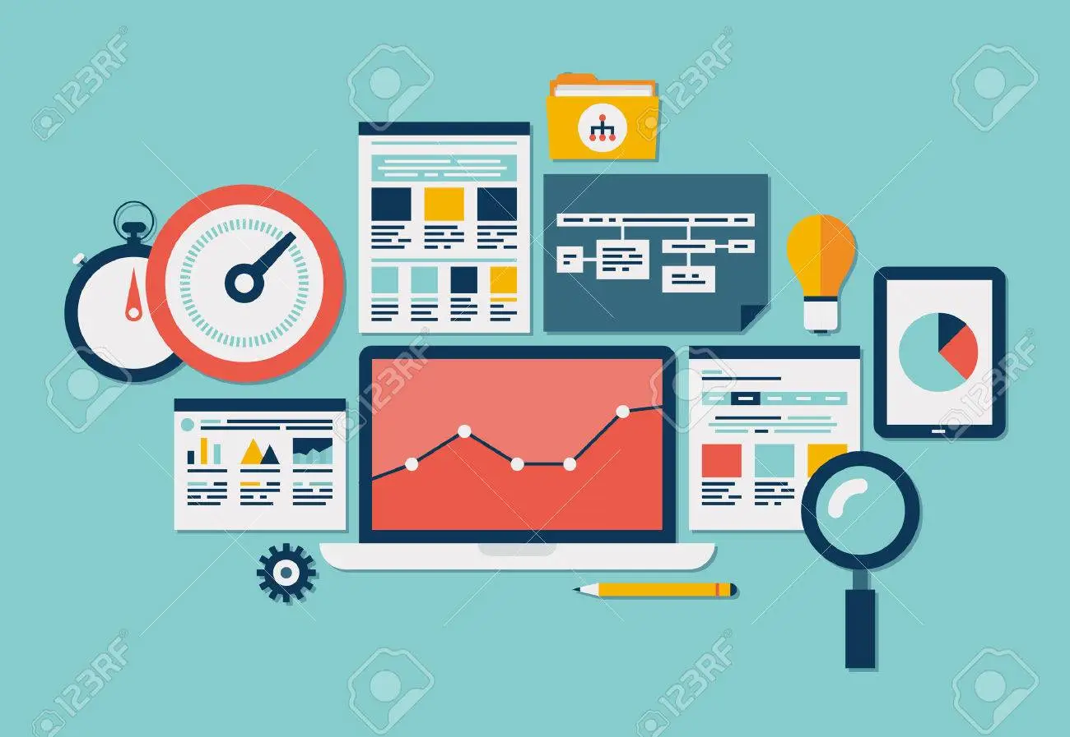
Website Optimization
Website optimization is an important aspect of digital marketing that can help the software company improve its search engine rankings and make it more visible to the target audience.
For example, the company can make changes to the website's content, structure, and design to ensure it is user-friendly and optimized for search engines.
Additionally, the company can implement search engine optimization techniques, such as keyword research and backlinking, to improve its ranking on search engines.

Slide 5

Content Marketing
Content marketing is an effective way for the software company to establish its brand and expertise in the target regions.
For example, the company can create and distribute blog posts, articles, infographics, and other types of content that are relevant and valuable to the target audience.
Additionally, the company can use social media to share this content and reach a wider audience.

Slide 6
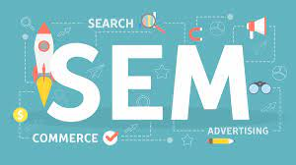
Search Engine Marketing
Search engine marketing is an effective way to drive traffic to the company's website and increase its visibility on search engines.
For example, the company can run pay-per-click advertising campaigns on search engines, such as Google AdWords, to reach the target audience.
Additionally, the company can implement search engine optimization techniques, such as keyword research and backlinking, to improve its ranking on search engines.

Slide 7
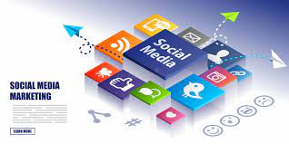
Social Media Marketing
Social media is a powerful tool for the software company to reach its target audience and build brand awareness.
For example, the company can use LinkedIn and Twitter to engage with its followers and share content.
Additionally, the company can run advertising campaigns on these platforms to reach a wider audience.

Slide 8

Influencer Marketing
Influencer marketing is an effective way for the software company to reach its target audience and increase brand visibility.
For example, the company can partner with relevant influencers and bloggers in the target regions to create sponsored content and promote its services.
Additionally, the company can work with these influencers to reach their followers and expand its reach.

Slide 9

Email Marketing
Email is an effective way for the software company to engage with its target audience and keep them updated on its services and updates.
For example, the company can send newsletters, promotional emails, and other types of emails to reach its target audience.
Additionally, the company can segment its email list based on the preferences of the target audience to improve the effectiveness of its email marketing campaigns.

Slide 10
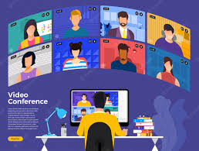
Webinars and Virtual Events
Hosting webinars and virtual events is an effective way for the software company to educate and engage with its target audience.
For example, the company can host online events to share its expertise and build relationships with potential customers.
Additionally, the company can use these events to gather customer feedback and improve its services and marketing strategy.

Slide 11

Localization
Localization is an important aspect of digital marketing that involves customizing the company's marketing materials and website for the target regions.
For example, the company can adapt the language, images, and messaging used in its marketing materials to appeal to local preferences and cultures.
This can help the company better reach its target audience and build its brand in the target regions.

Slide 12
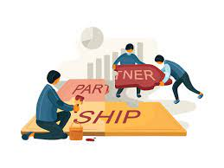
Partnerships
Building partnerships with relevant organizations and businesses in the target regions is an effective way for the software company to reach a wider audience and expand its reach.
For example, the company can partner with local organizations to co-host events, create.

Slide 13

https://github.com/diptanshu131

